Slide 1
CGB1201 – JAVA PROGRAMMING
Department of Artificial Intelligence and Machine Learning
Academic Year: 2024 – 2025 (Odd Semester)
Register Number : 2303811714821058
Name : B.R.VIMAL AANANTH
Year : II-YEAR
Semester : III-SEM
Section : A
Date : 03-12-2024

Slide 2
Title of the Project
CURRENCY CONVERTER APPLICATION

Slide 3
Problem Identification
The Currency Converter Application addresses these problems by providing a dynamic, user-friendly platform that supports conversion between all major currencies. By integrating predefined exchange rates (or real-time API-based data in the future), the program ensures accurate conversions and eliminates manual errors. The application offers an intuitive interface that can handle complex multi-currency conversions efficiently, providing a reliable solution for personal and professional use.

Slide 4
Objective
The objective of the Currency Converter Application is to provide a reliable and efficient tool for real-time currency conversion. This application aims to simplify global transactions by fetching live exchange rates, performing accurate calculations, and presenting results through a user-friendly interface. By leveraging modern software development practices, the application is designed to cater to individuals and businesses involved in travel, trading, and financial transactions.

Slide 5
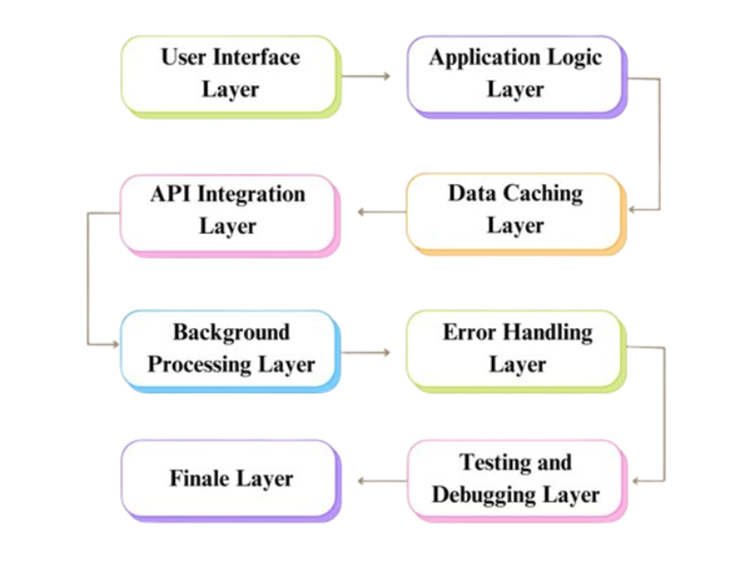
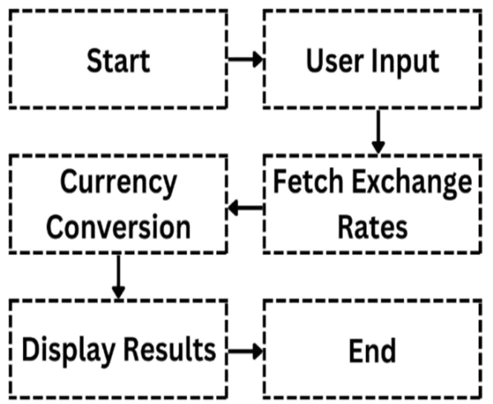
Proposed Architecture

Slide 6
Java Programming - Concepts Used
Object-Oriented Programming (OOP): The application uses encapsulation, inheritance, and polymorphism to ensure modular, secure, and flexible code that is maintainable and scalable.
Graphical User Interface (GUI): JavaFX or Swing is used to build a user-friendly interface, ensuring ease of use for currency conversion tasks.
API Integration & Exception Handling: API integration fetches real-time exchange rates, while exception handling manages errors like invalid inputs and connection issues.
Multi-threading & Collections: Multi-threading allows background tasks without interrupting the UI, and collections ensure efficient data processing and currency conversion.

Slide 7
List of Modules
User Interface Module
API Integration Module
Currency Conversion Logic Module
Error Handling Module
Data Caching Module
Multi-threading Module
Testing and Debugging Module

Slide 8
Module Description
User Interface Module Provides input fields for selecting currencies and entering amounts, displaying results and error messages through a responsive interface using JavaFX or Swing.
API Integration Module Connects to an API to fetch real-time exchange rates, processes responses, and handles connection errors to ensure accurate data.
Currency Conversion Logic Module Implements the algorithm for converting amounts between currencies using the latest exchange rates, ensuring accuracy.
Error Handling Module Detects invalid inputs, API errors, and network issues, providing feedback and maintaining application stability.

Slide 9
Module Description (Cont..)
Data Caching Module Temporarily stores exchange rates to reduce API calls, improving performance and response time for repeated conversions.
Multi-threading Module Handles background tasks, such as fetching exchange rates, without interrupting the user interface, ensuring smooth operation.
Testing and Debugging Module Validates all components of the application, identifying and resolving bugs in logic, API connectivity, and UI functionality.

Slide 10
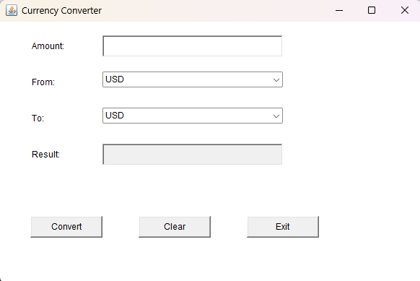
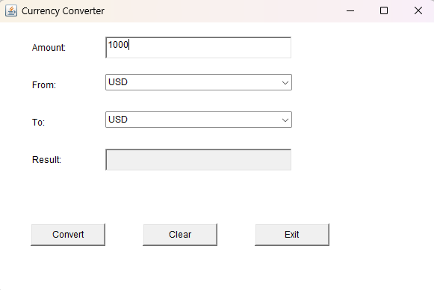
Screenshots
Interface screenshot
Amount Entering Screenshot

Slide 11
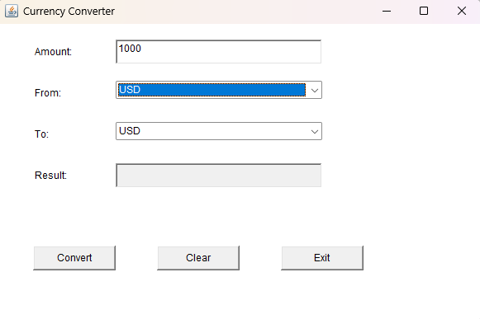
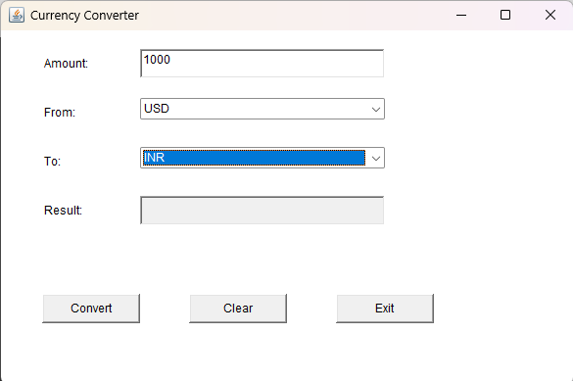
Screenshots
Select Currency (From) Screenshot
Select Currency (To) Screenshot

Slide 12
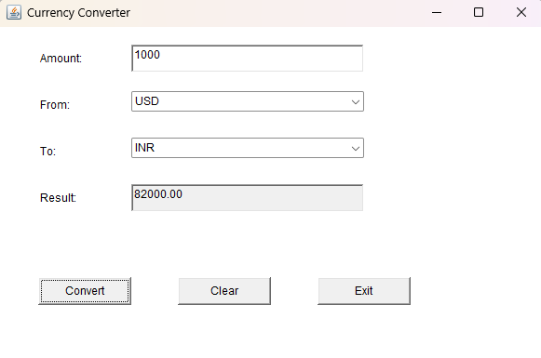
Screenshots
Result Screenshot

Slide 13
Results
The Currency Converter Application successfully provides an efficient and accurate solution for converting between a wide range of global currencies. It supports multiple currencies and ensures reliable conversions using predefined exchange rates. The user-friendly interface simplifies the process of currency conversion, making it accessible for both individuals and businesses. The application handles currency codes and names correctly, preventing confusion and errors. Additionally, it is designed for future scalability, with the potential for real-time exchange rate integration and the ability to add more currencies. Overall, the application meets its objectives, offering a practical tool for currency conversion.

Slide 14
Conclusion
The Currency Converter Application has successfully addressed the need for real-time, accurate currency conversion by leveraging Java's powerful programming features and API integration. The application provides a user-friendly interface, ensures accurate conversions through up-to-date exchange rates, and handles errors effectively to maintain stability. By incorporating multi-threading and data caching, the app delivers fast and responsive performance even during simultaneous tasks. Through comprehensive testing and debugging, the application has proven to be reliable, meeting its objectives of offering a robust solution for global currency conversion. This project demonstrates the potential of Java for building scalable and efficient applications in real-world scenarios.

Slide 15
Thank You
Any queries???

